Slide 1
Update on the development of Waterbeach Barracks
Urban&Civic
June 2023
Urban&Civic

Slide 2
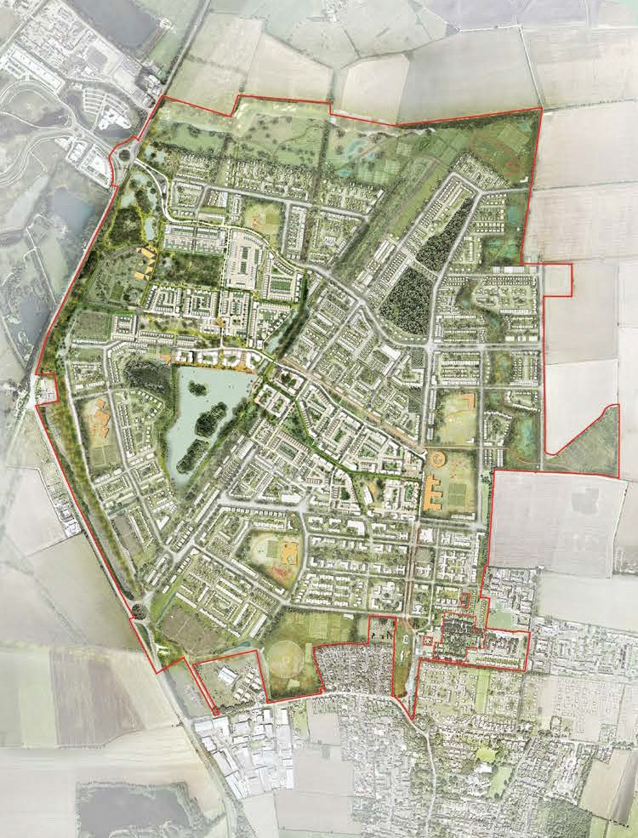
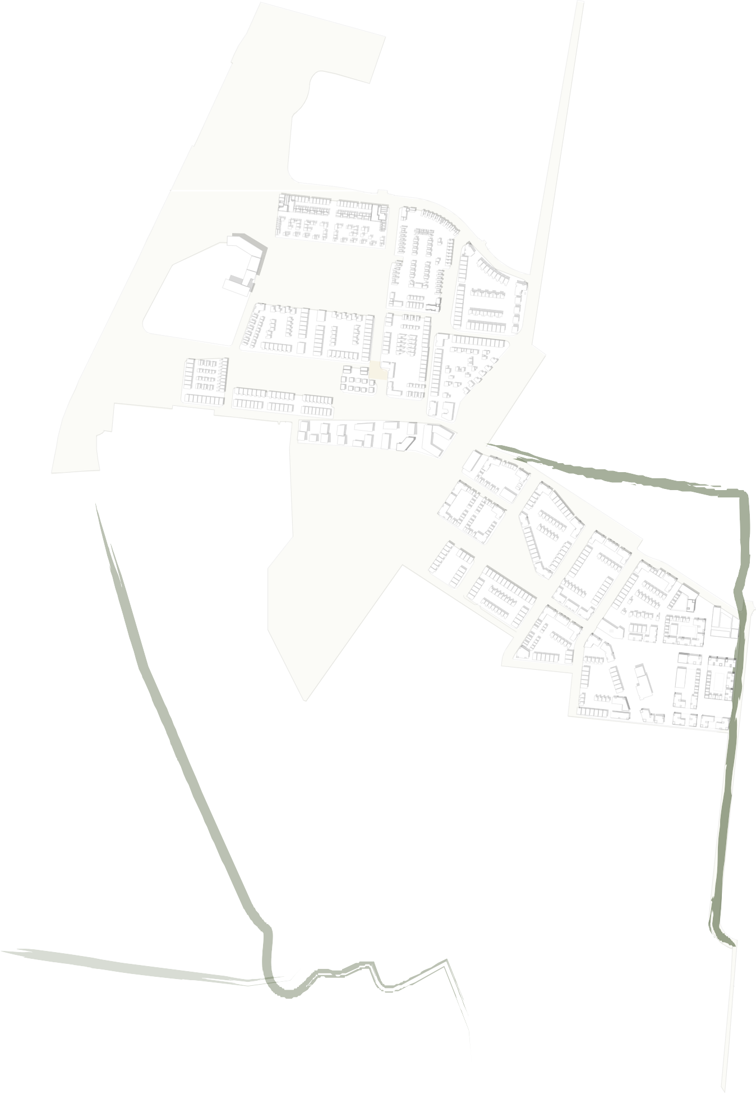
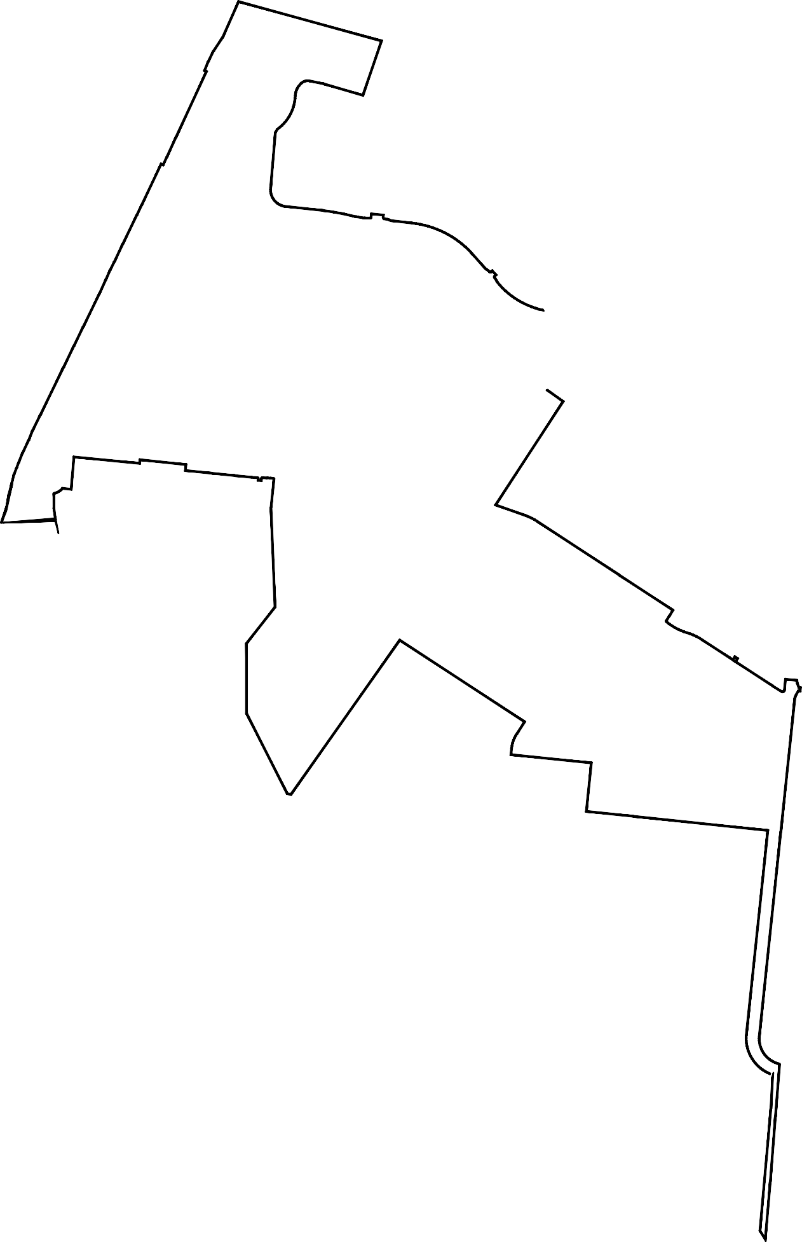



The Big Picture
Waterbeach Outline Masterplan
250 acres of green space for parks, play spaces and sports.
6,500 new homes available to buy or rent, with a range of affordable options.
Extensive on and off-site cycle connections, public transport services and active travel schemes.
34 acres of ecology habitats designed for nature.
5 new schools – three primary schools, a secondary school and a special needs school.
Town centre with health centre, shops and services and a range of community facilities.
Development boundary
First phase of development
Key walking and cycling routes
5
2

Slide 3
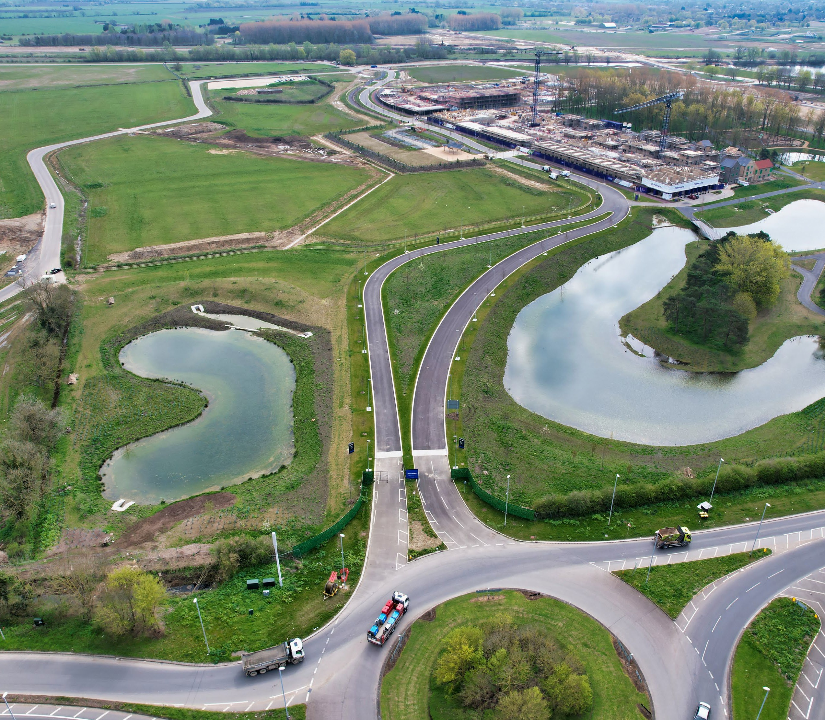
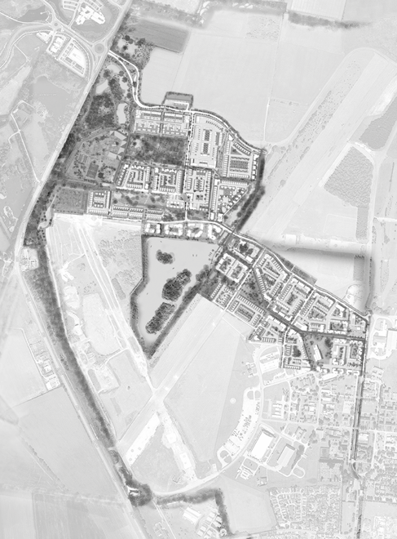
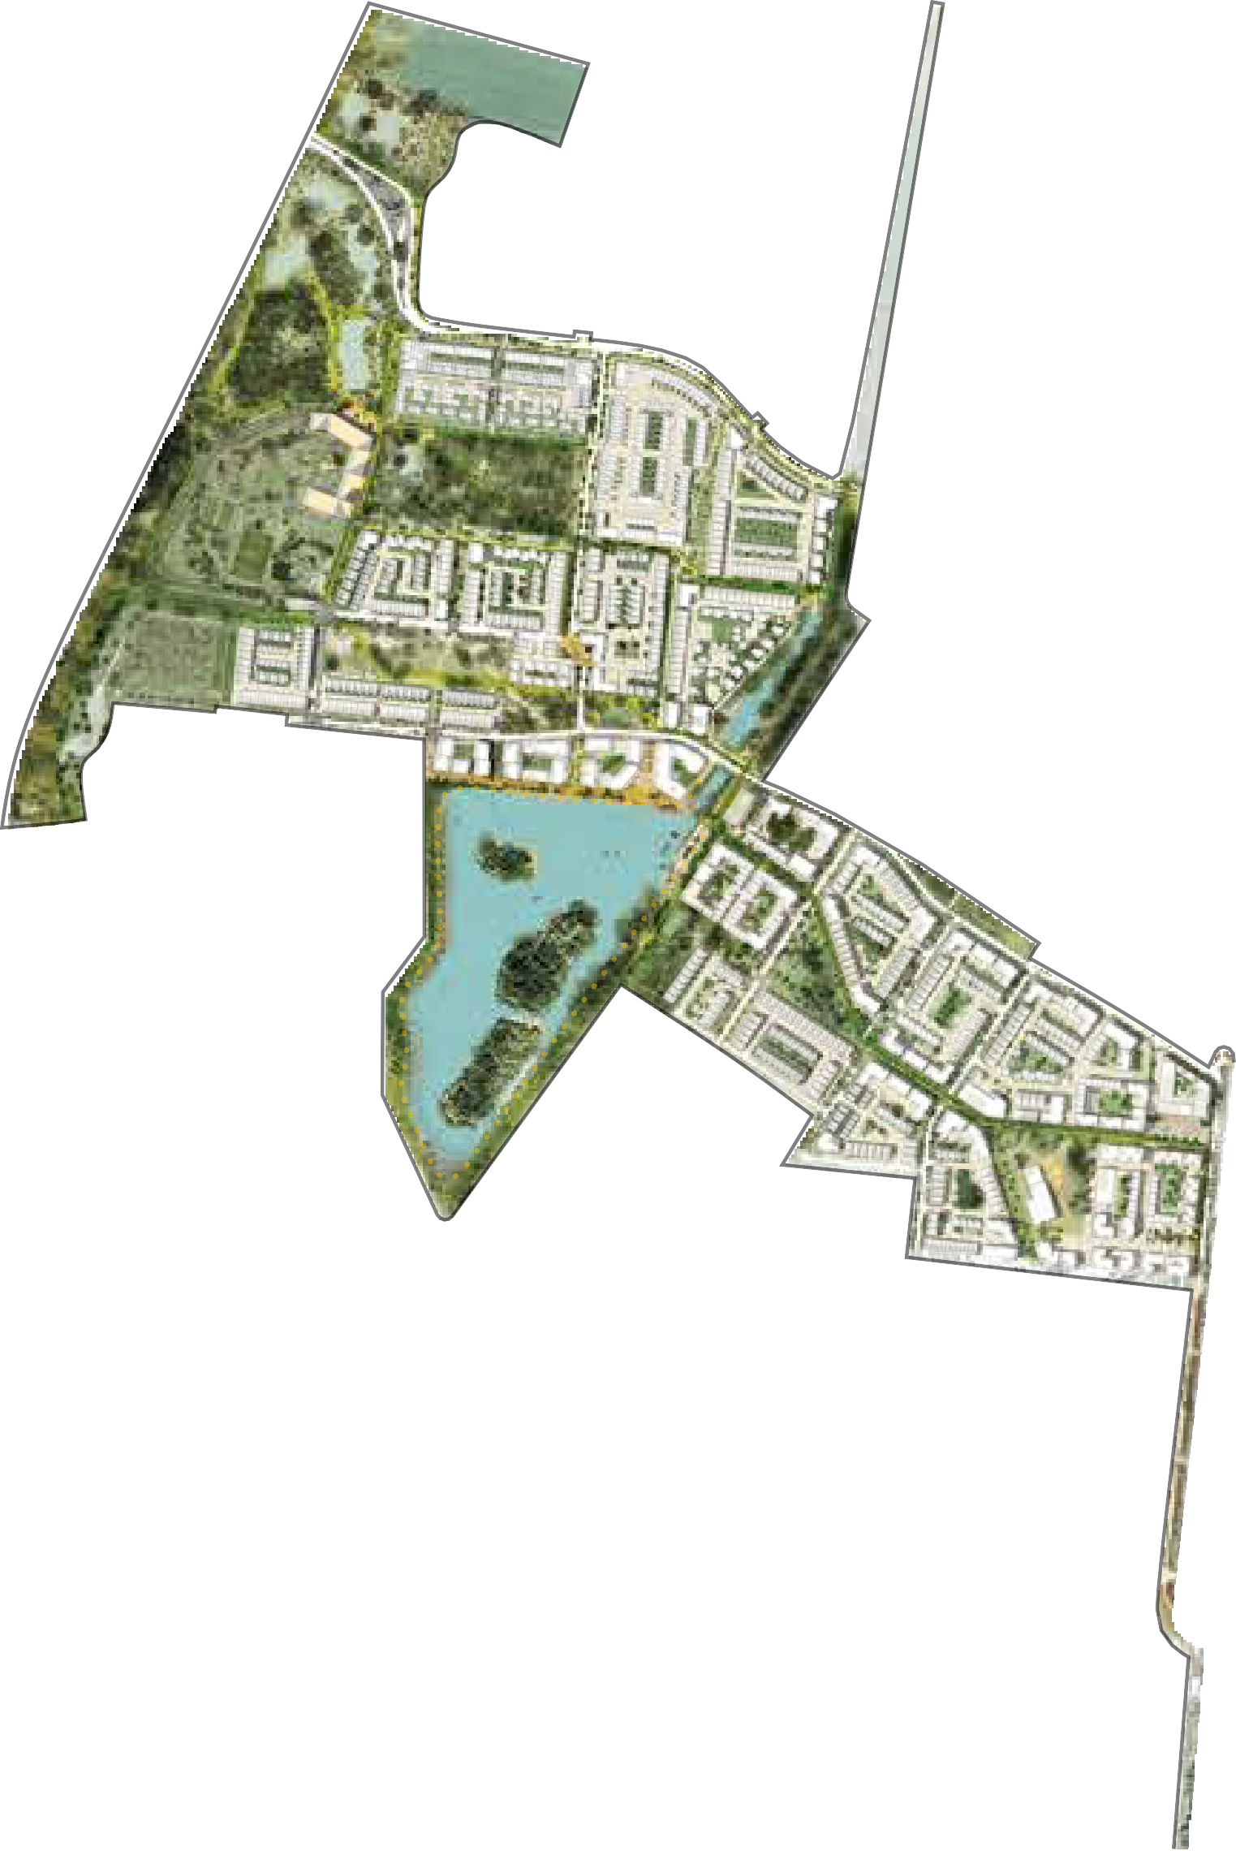
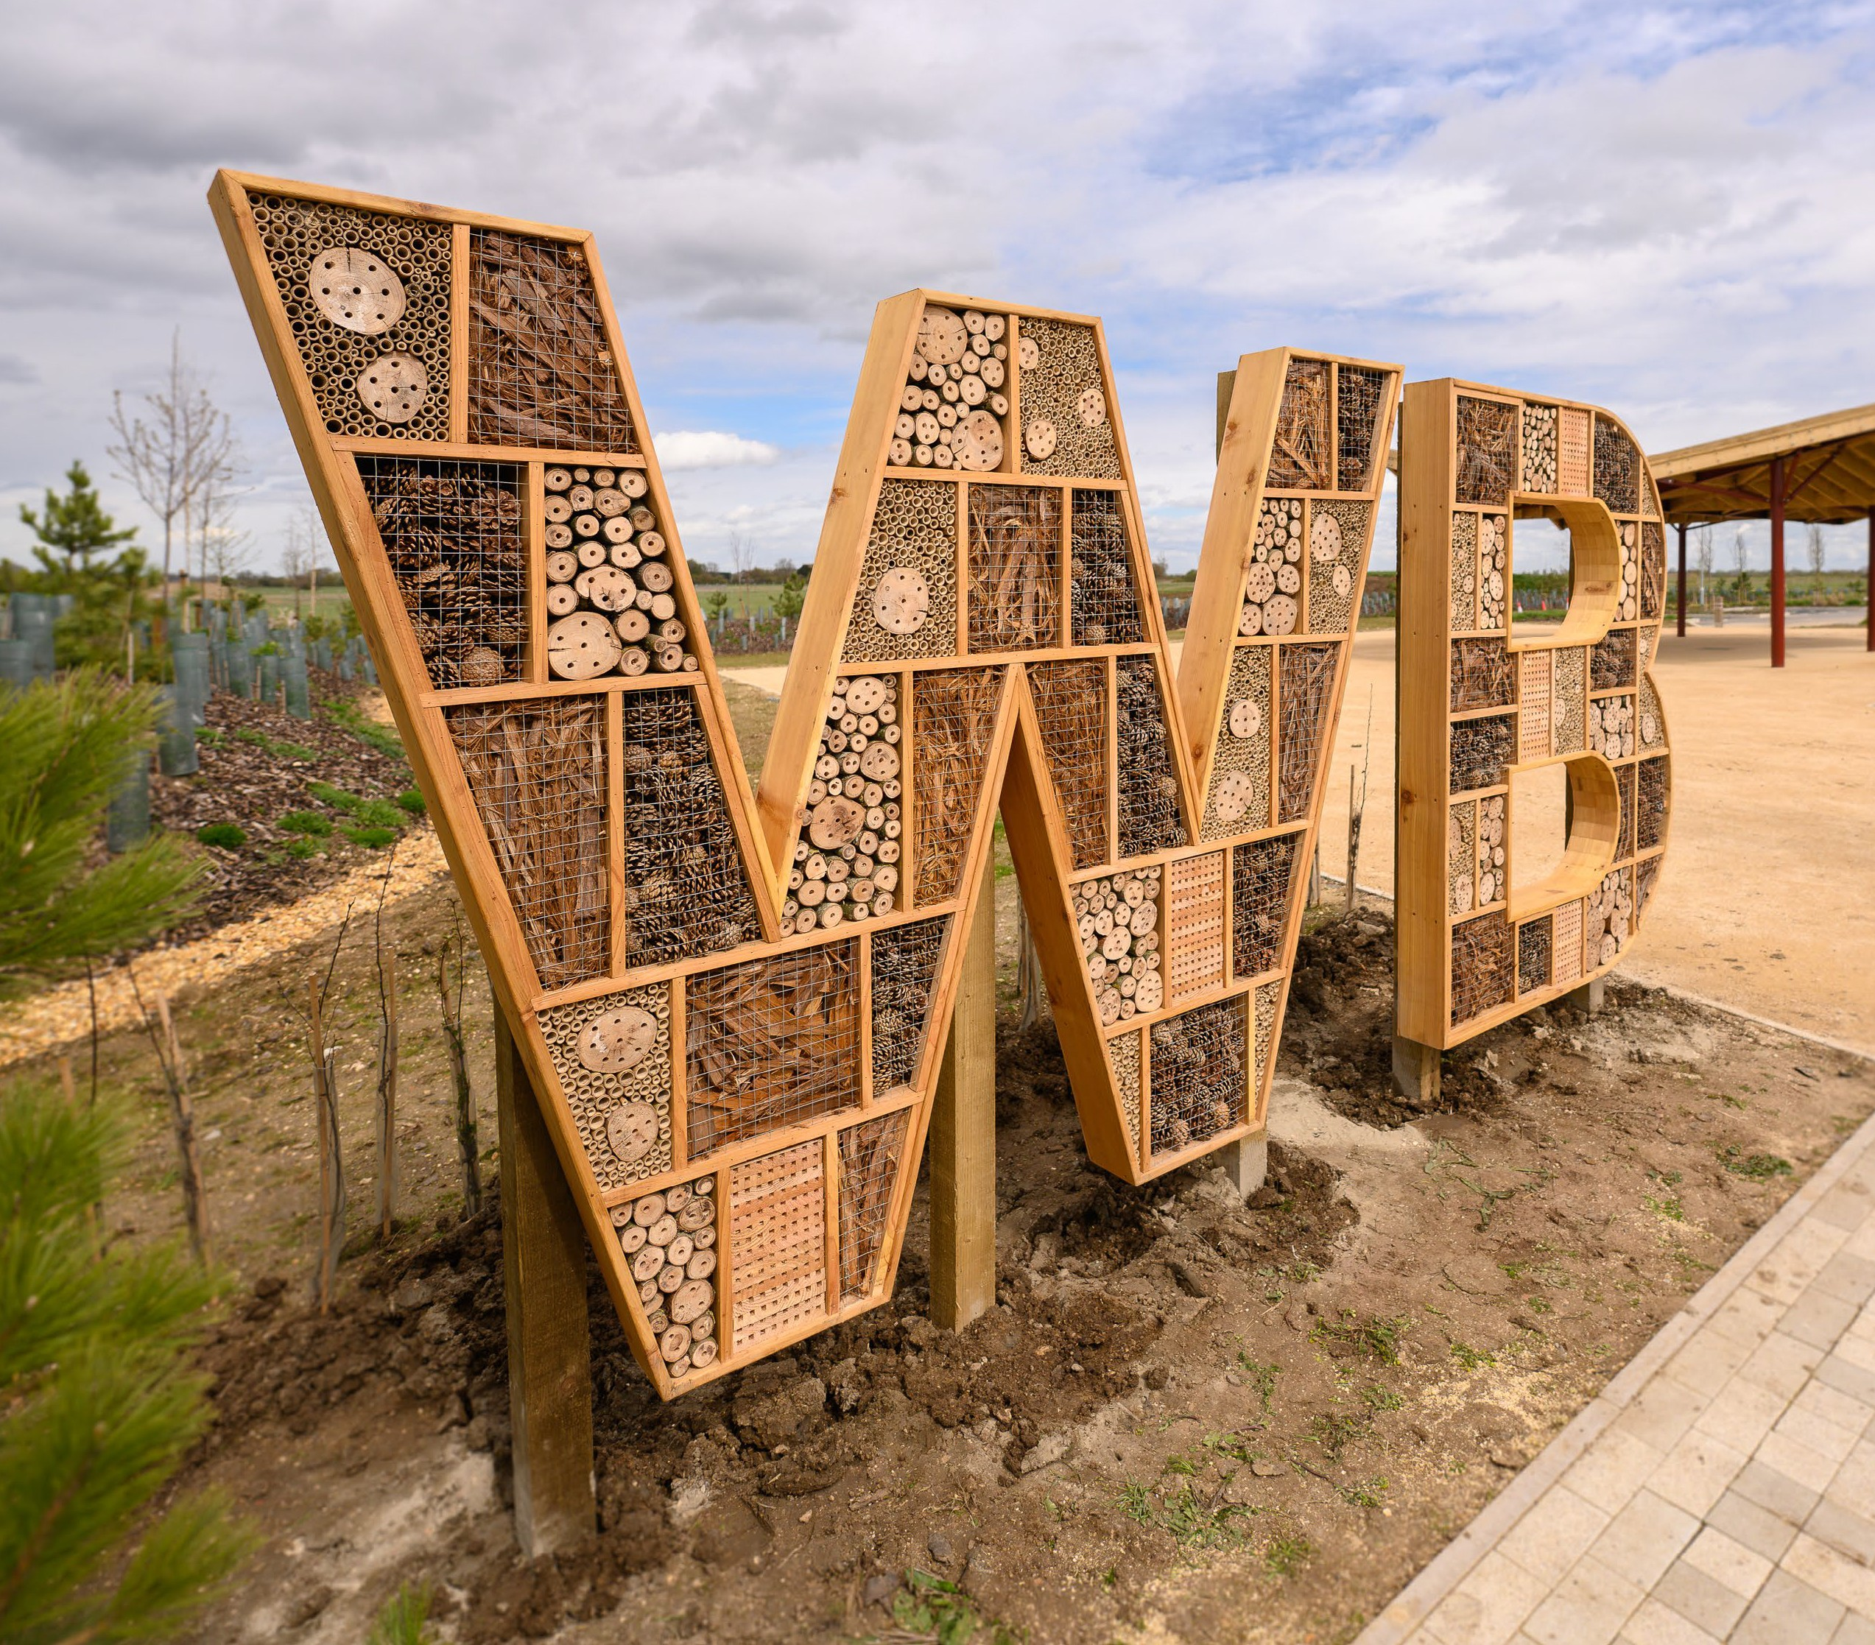
The First Phase of Waterbeach
Sustainable Travel Hub
Space for imaginative play
The Causeway
Deneia Primary Academy
Wild Woods Play Area
Allotments
(coming in 2026)
Waterbeach Gardens Lake
Community centre, café and interim health centre
(coming in 2024)
1.2km lake loop
Memorial Park
Sports Hall & The Playground assault course
Mere Way cycle route
Waterbeach Military Heritage Museum
Squash courts
Tillage Way cycle route
Waterbeach Causeway
1
3
2
4
5
6
7
9
8
10
11
15
12
16
Walking and cycling routes
17
13
14
15

Slide 4
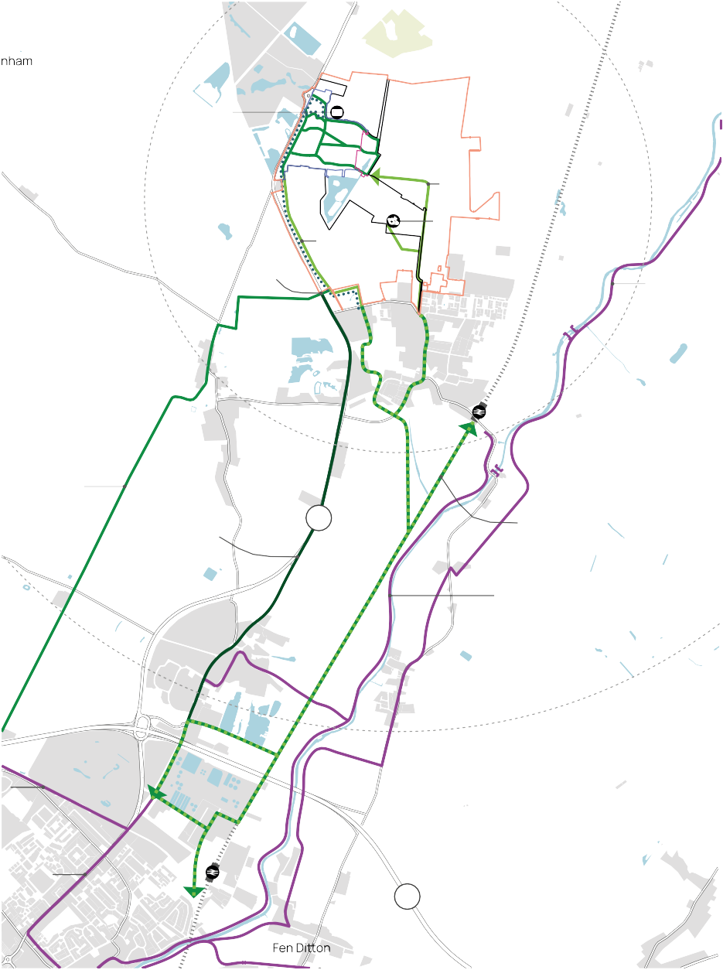
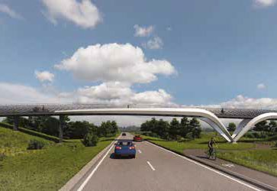
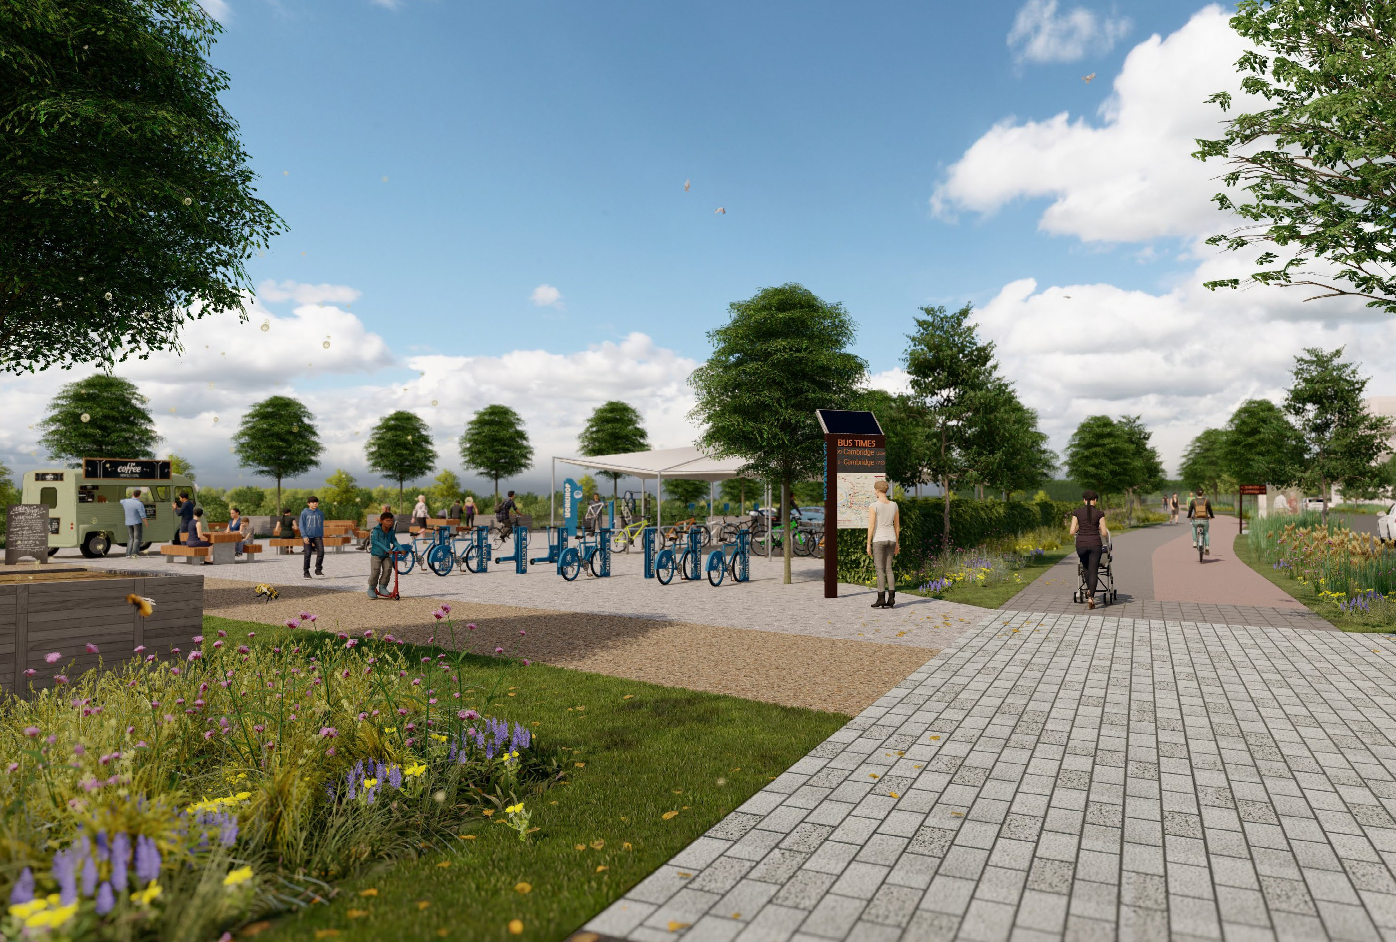
Mere Way
Cambridge Research Park
Denny Abbey
)
Sustainable travel hub
k
l
a
w
n
i
m
0
3
C.28
Route Part i
Existing Sports Hall
x
o
ppr
a
(
m
k
C.28
Route Part ii
A10 Bridge
5
.
2
Waterbeach
Fen Rivers Way
Landbeach
re Way cycle route. A route for NMUs to
Cambridge
Route to Cambridge via upgraded A10 cycle path and Milton cycle- way improvements
A10
Proposed Waterbeach Greenway – a route for pedestrians, cyclists and equestrians
Sustrans Route 11 to Cambridge via
Harling Way/River Cam
Milton
Horningsea
Cambridge Science Park
OPA boundary KP1 boundary
KP1 north boundary
Lake spur RMA boundary
Waterbeach Greenway proposal – Non-motorised Users (NMU)
Mere Way cycle route for NMU’s Cycle route
Early on-site equestrian routes
Temporary early phase on-site pedestrian and cycle routes
s 1
Sustrans Route 11
Cambridge North
A14
Chesterton

Slide 5


Stonebond
89 homes
Sales now launched and marketing suite open 10am-5pm
7 days a week
Shared Ownership Rent to Buy Affordable Social Rent

Slide 6
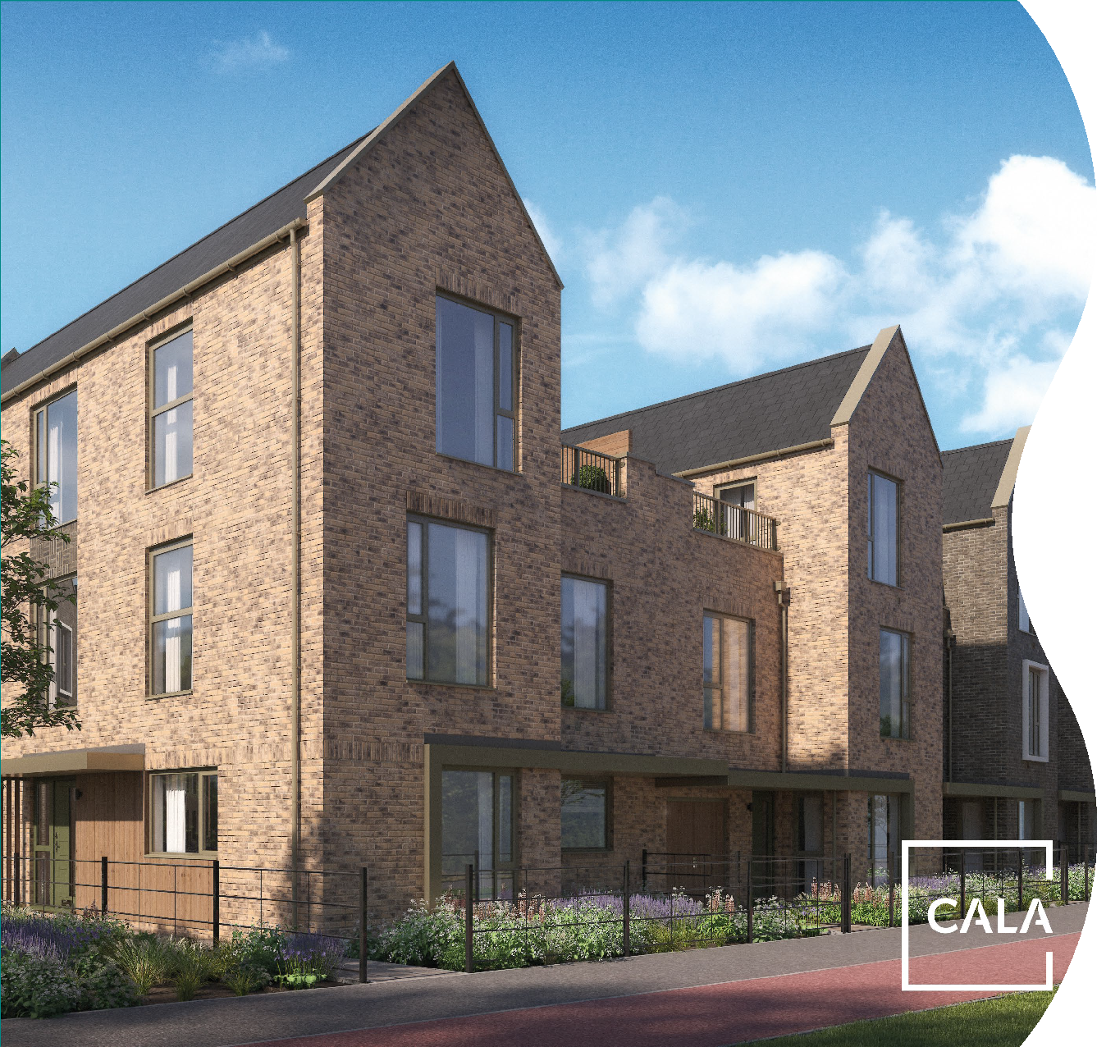
CALA Homes
111 homes
Launching
mid-July
Shared Ownership Rent to Buy Affordable Social Rent

Slide 7
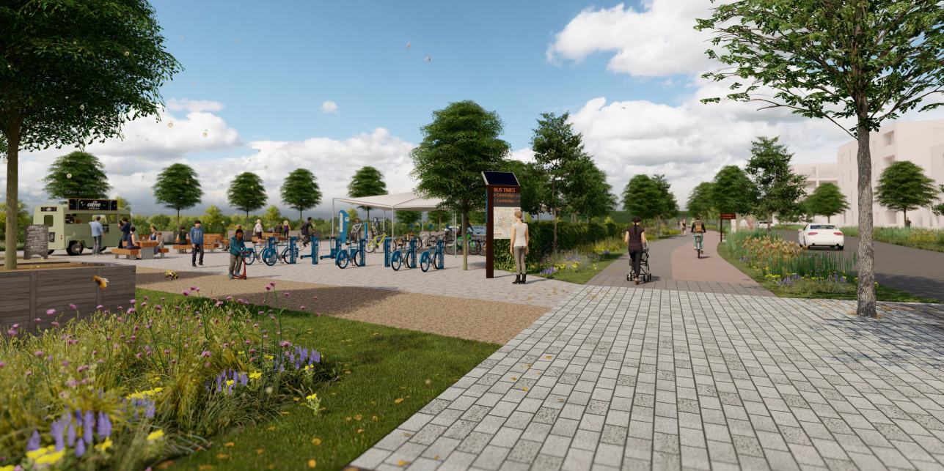
Welcoming New Residents
Creating a welcoming and inviting community for new residents
Resident packs – detailed information about the site for new residents, helping to create a sense of pride and ownership in the new community
Developing connections with shared use of community facilities and site activation
Encouraging use of sustainable travel options
Building links between the new and existing residents
Installation of wayfinding and site information

Slide 8
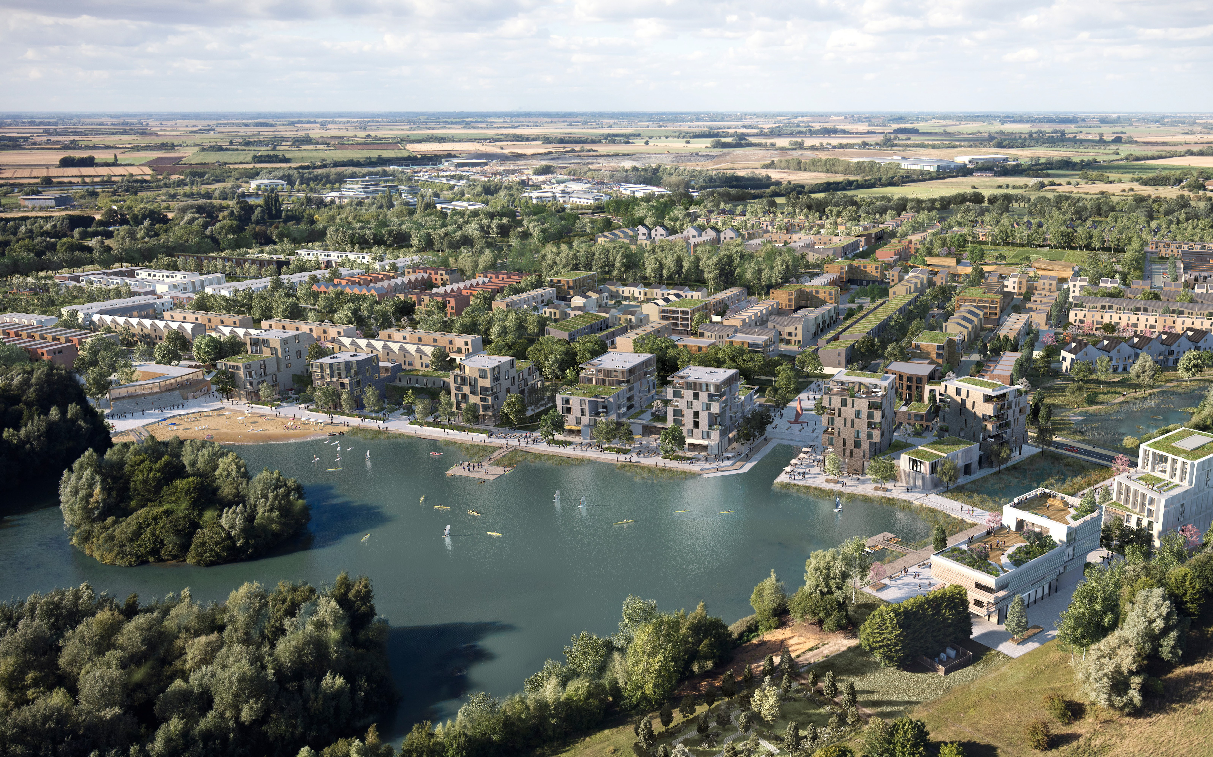
Next steps
Mere Way Work commencing
June
June/July
Next community newsletter
September
Summer at the Beach
September/October
First residents moving in

Slide 9
Paul Mumford
paul.Mumford@urbanandcivic.com
Rebecca Britton
rbritton@urbanandcivic.com
Fiona Reardon-Rose
fiona.reardon-rose@urbanandcivic.com
Caroline Ward
caroline.ward@urbanandcivic.com
June 2023
Urban&Civic

