Slide 1
Western Park Sports Pavilion and Pitches
South Cambridgeshire
District Council

Slide 2
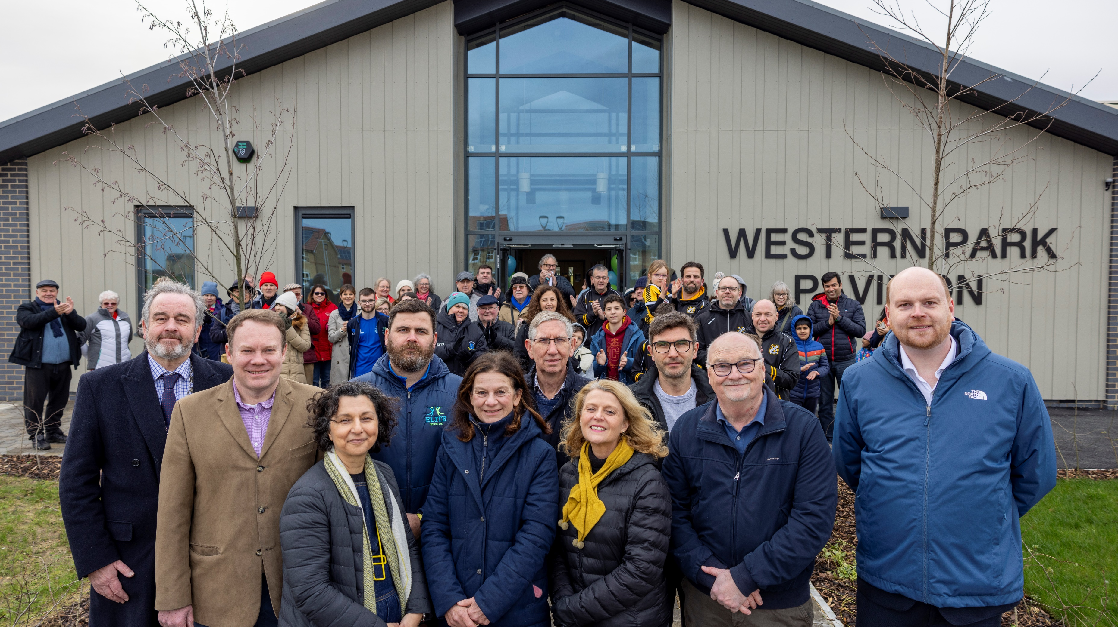

Slide 3
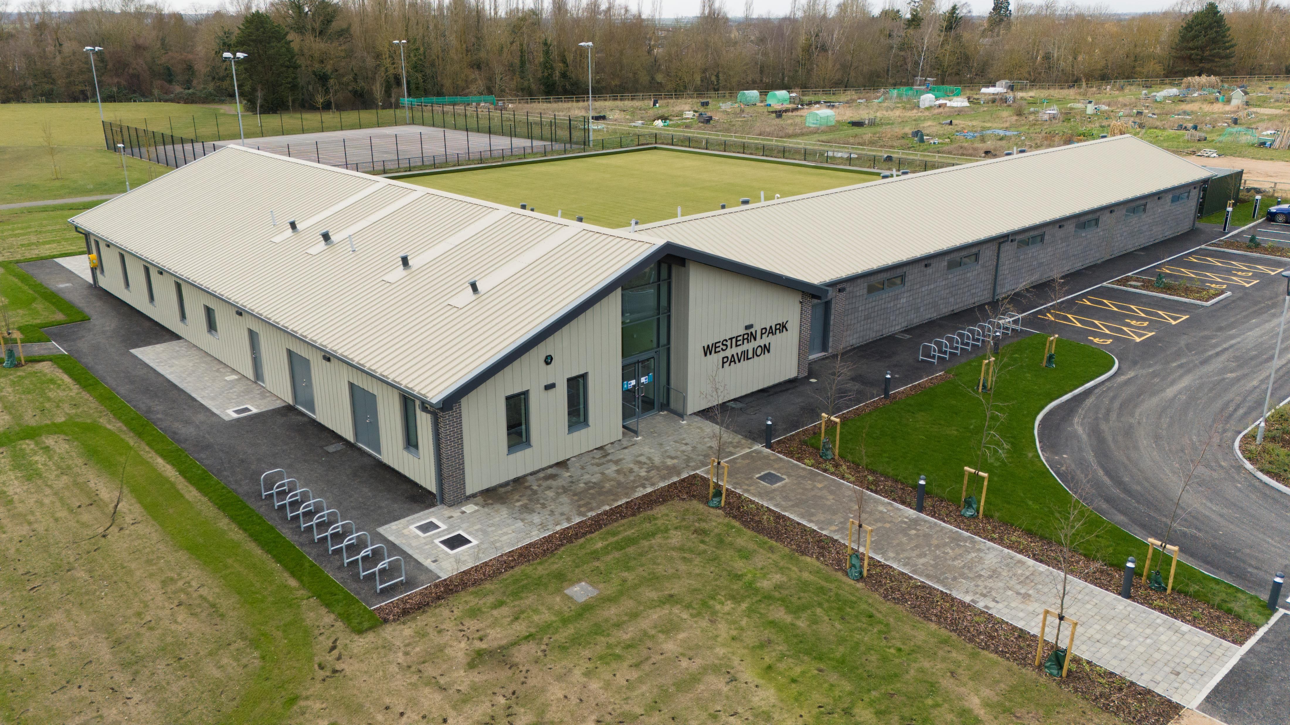

Slide 4
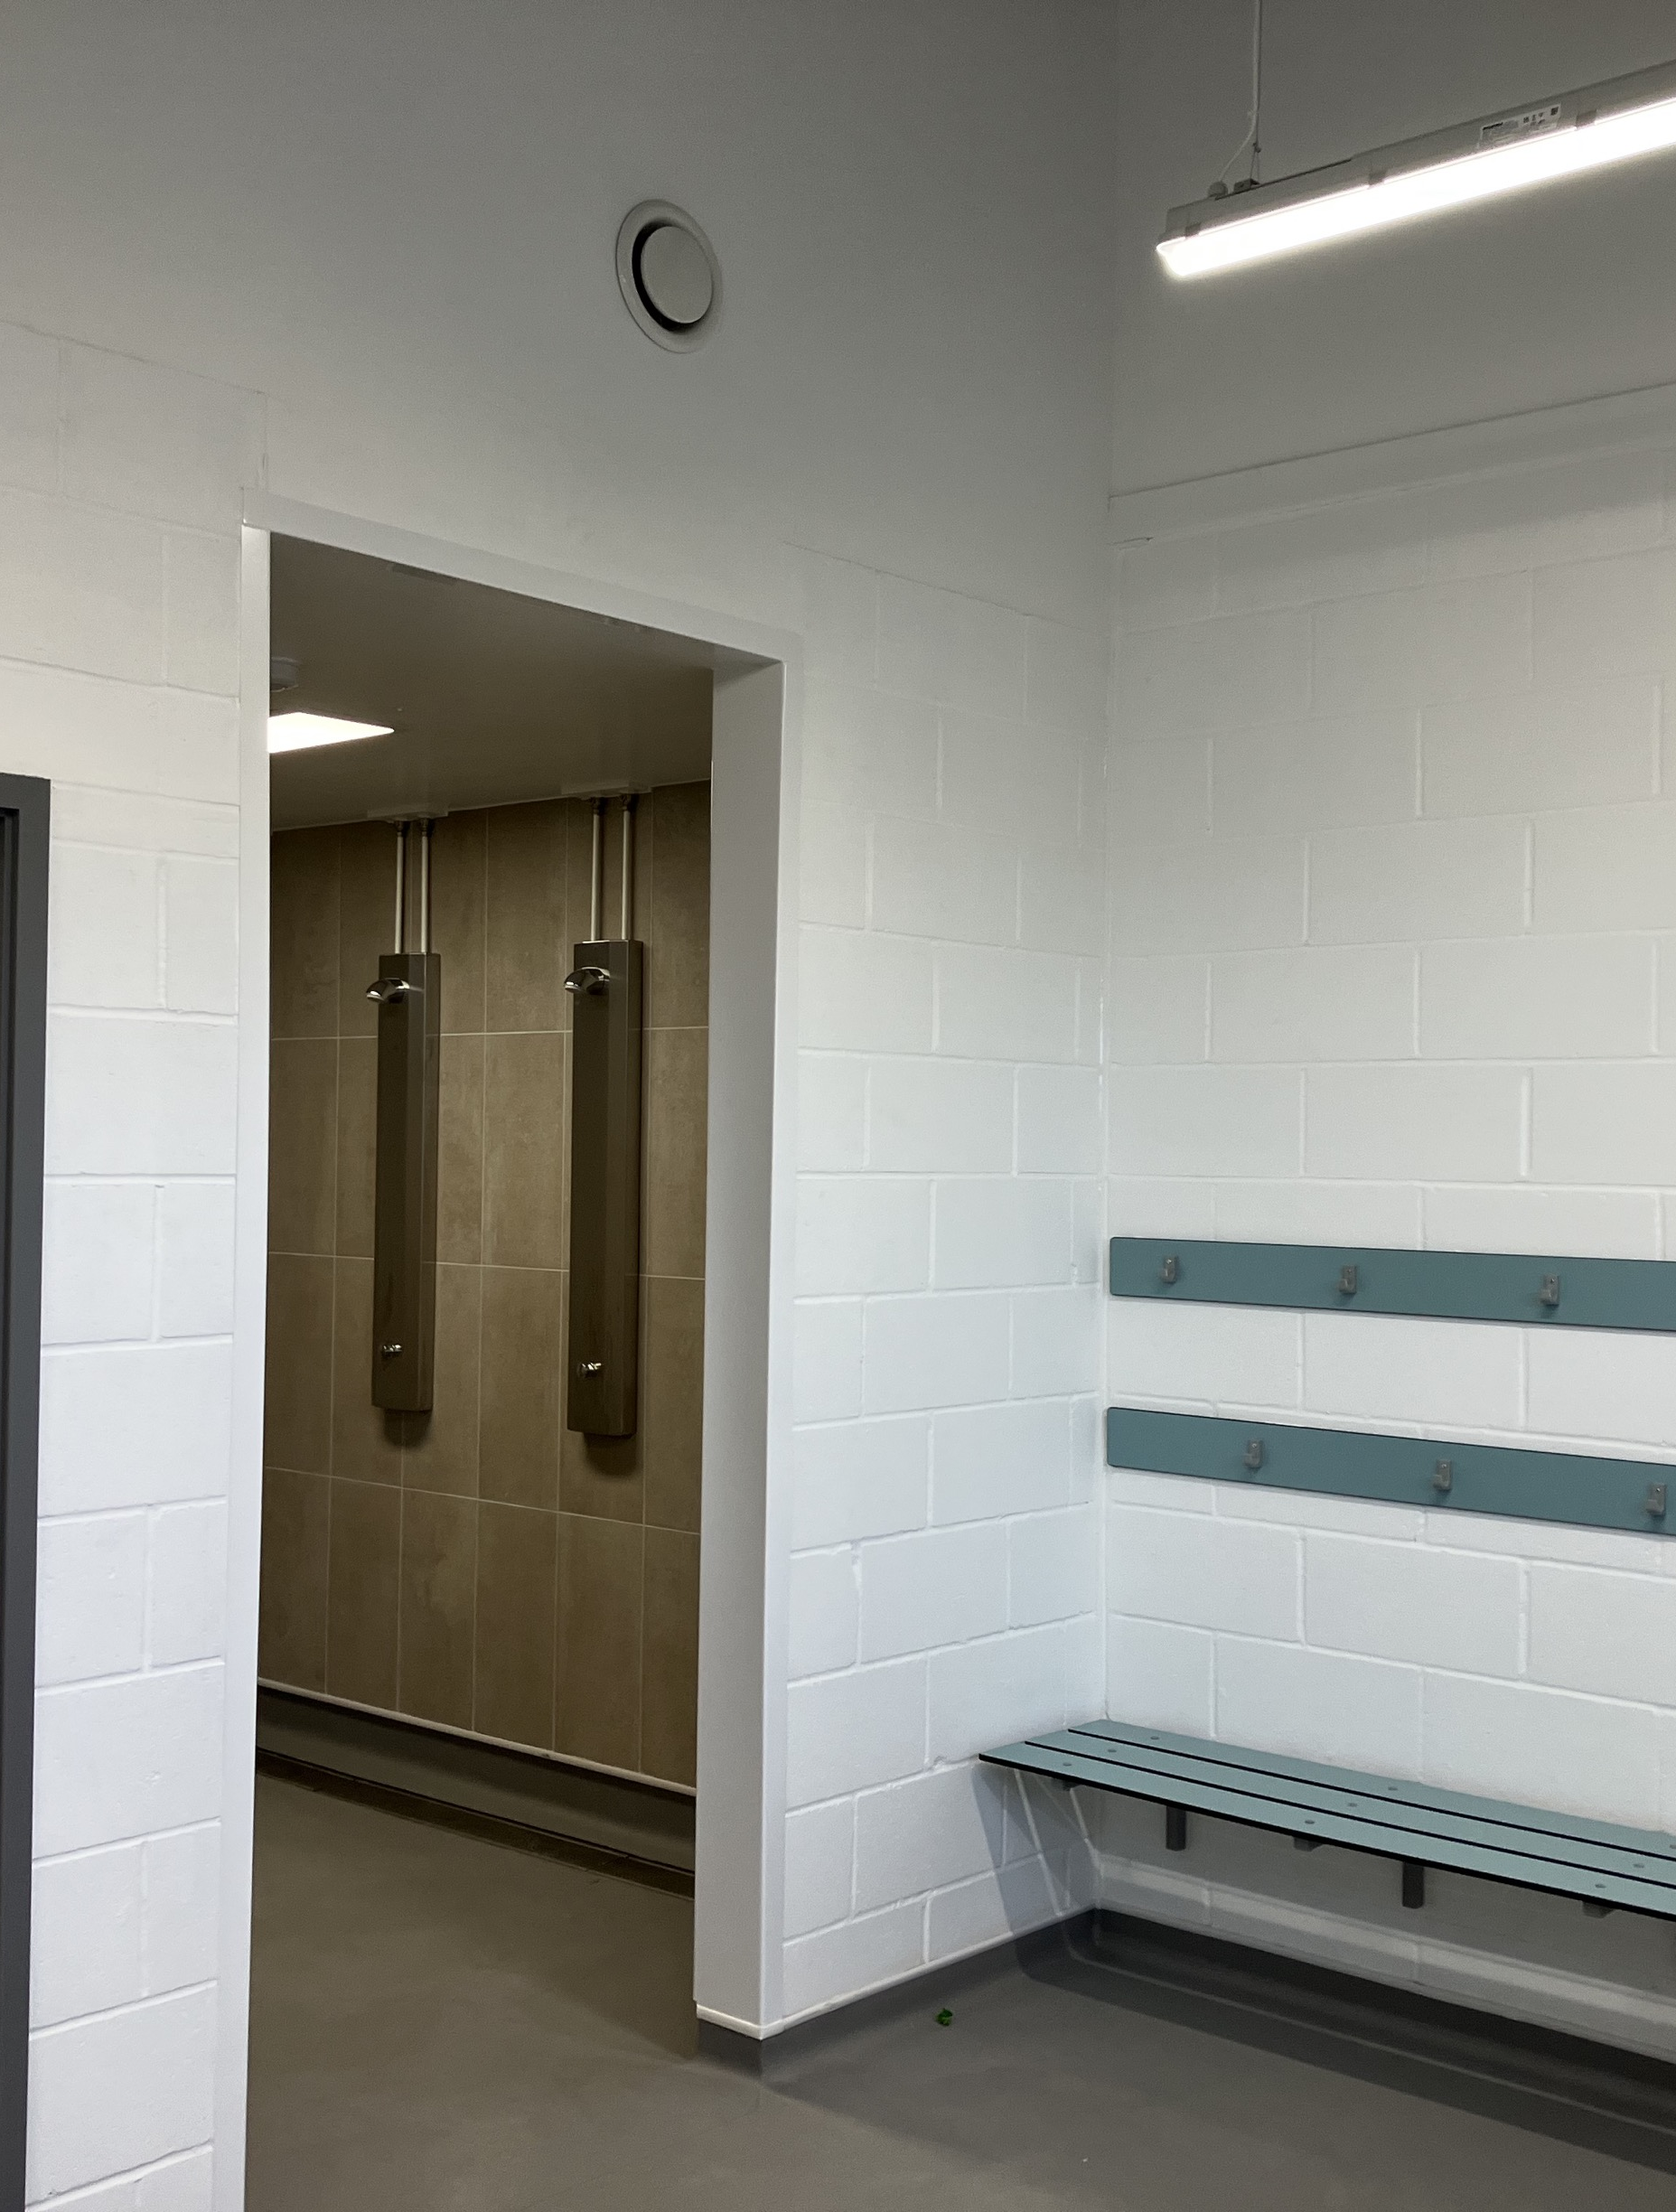
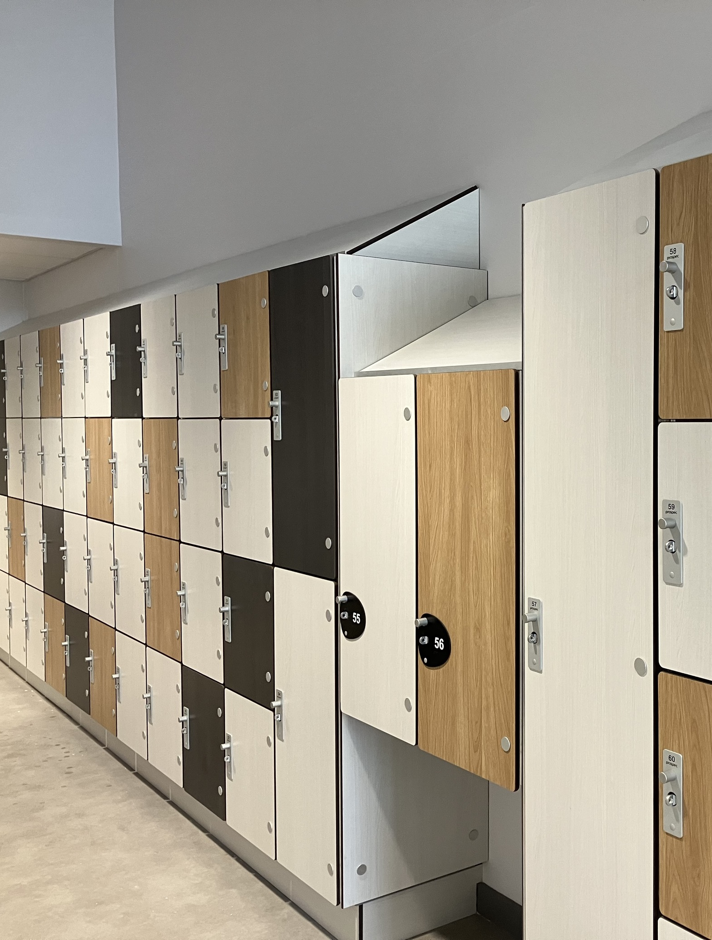
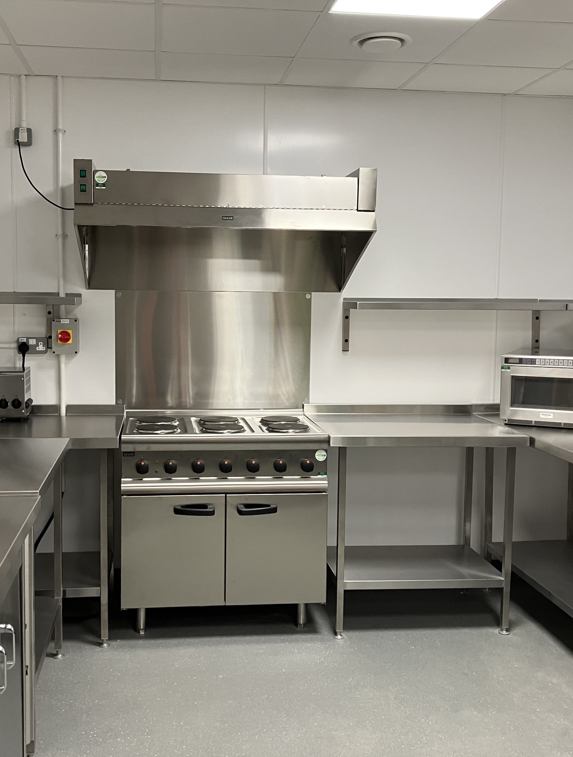
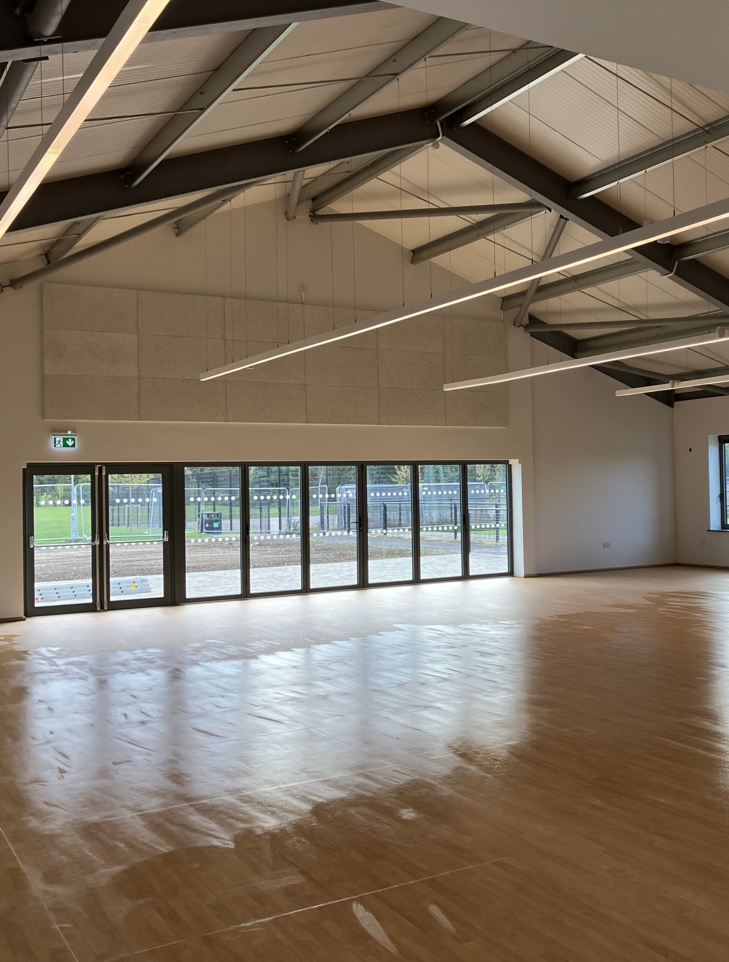
Phase 1 Sports Pavilion

Slide 5
Mobilisation
Image of staff advert
Plan for licence
Activation event

Slide 6
Booking Page

