Slide 1
Northstowe Phase 2 and 3 Update
Emma Brown
Notes:
.

Slide 2
Central One Update – Homes England
Phase 2b – Keepmoat

Slide 3
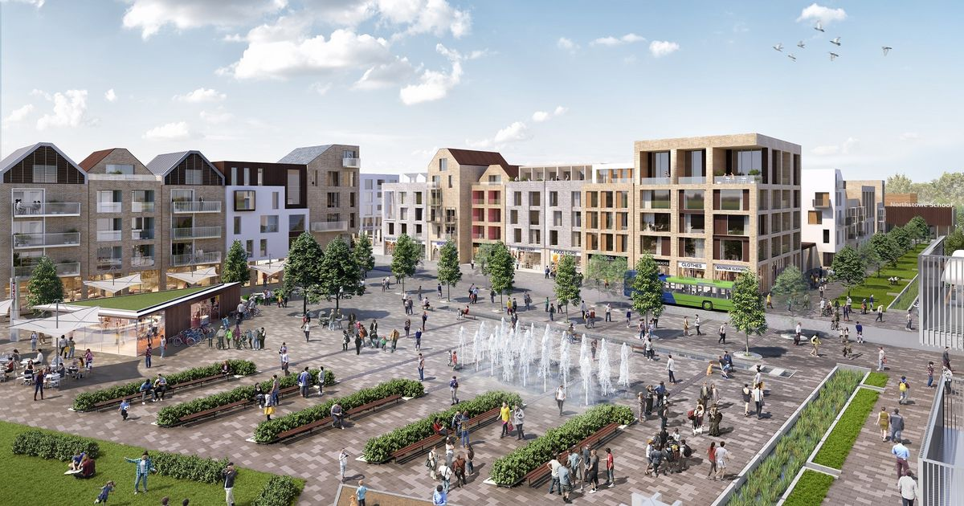
Central One – Northstowe Town Centre

Slide 4
Market Hall Convenience Store Space for Civic Hub (library/health/community space) Town gardens Play area Residential Units

Slide 5
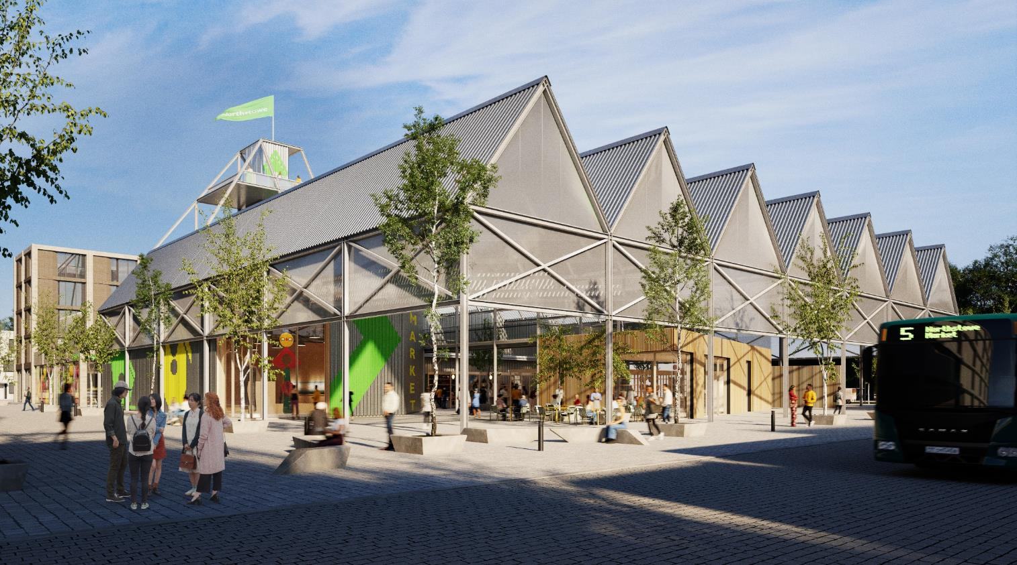

Slide 6
Central One - Programme
Developer has been selected – Sept. 2022
Homes England to announce development partner in January 2023
Development Partner to submit Reserved Matters planning application submission – early 2023
Construction starts – late 2023
Central One Complete – early 2027

Slide 7
Phase 2B - Keepmoat

Slide 8
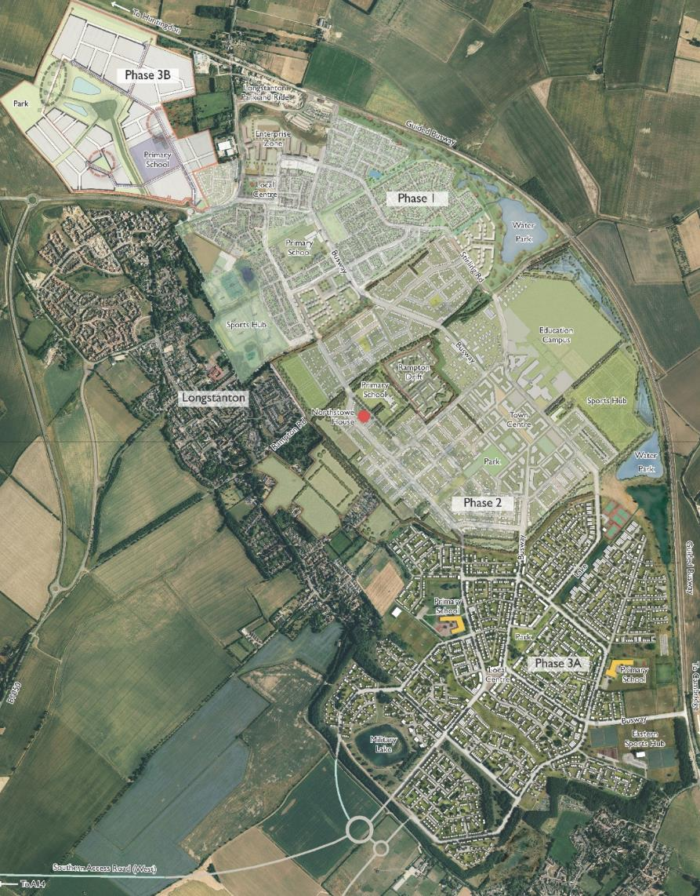
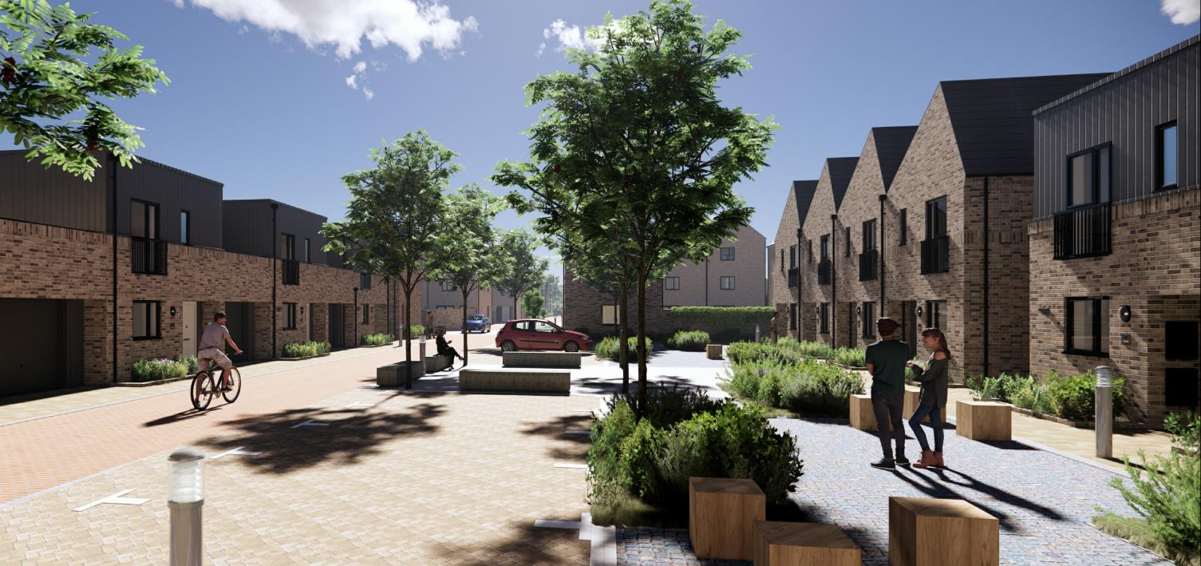
Phase 2b – Keepmoat (300 homes)
Notes:
Aiming to get on site later this year. Already shortlisted for a housing design award.

