Slide 1

Title slide
How to make a successful Zero Carbon Communities grant application

Slide 2

Welcome and introduction
Welcome and Introduction
Cllr Pippa Heylings, Chair of Climate & Environment Advisory Committee

Slide 3



Zero Carbon Communities grant

Slide 4
Speakers
Speakers
Emma Dyer- Climate and Environment Project Officer at South Cambridgeshire District Council
Siobhan Mellon- Climate and Environment Development Officer at South Cambridgeshire District Council
Sally Page- Cambridge Council for Voluntary Service (CCVS)
Sherryl Cousins- Gamlingay Eco Community Group

Slide 5
Aims of the scheme
Aims of the ZCC grant scheme
support communities to promote behavioural change and reduce reliance on fossil fuels
aligns with aspiration for net zero carbon by 2050 in our Zero Carbon Strategy
£100k total budget

Slide 6



Projects funded
Projects funded so far:
 |  |  |  |  | Other | Total
19-20 | Applications | 10 | 12 | 5 | 13 | 40
 | Awards | 1 | 7 | 4 | 7 | 19
20-21 | Applications | 15 | 10 | 20 | 0 | 45
 | Awards | 2 | 5 | 10 | 0 | 17

Slide 7
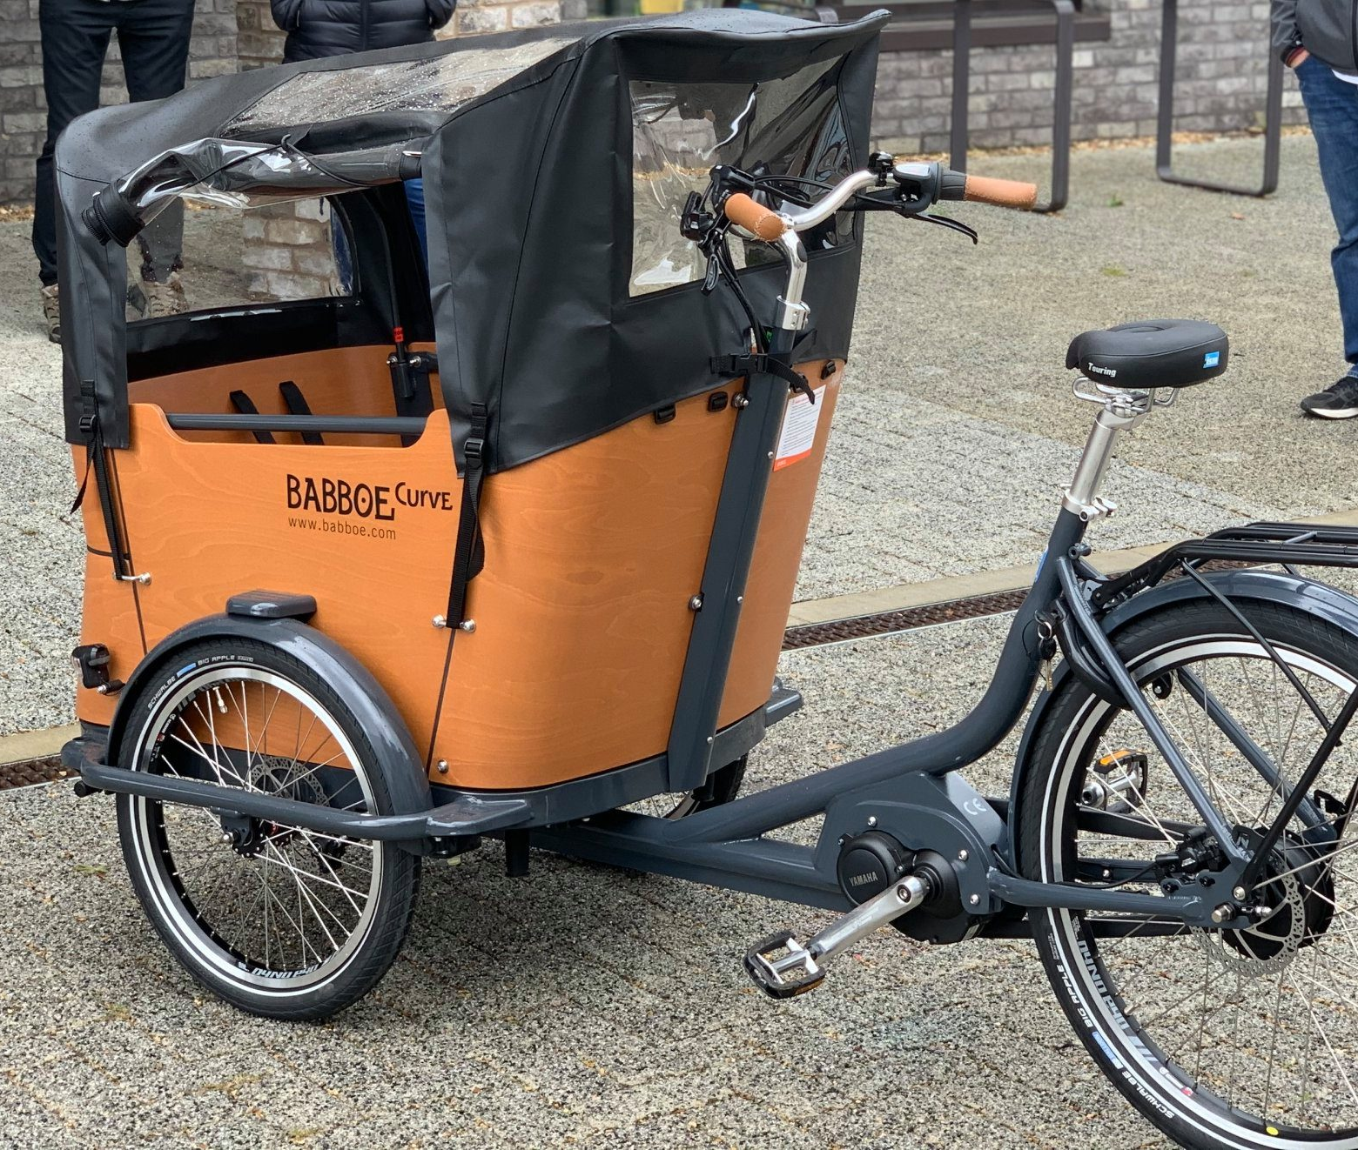
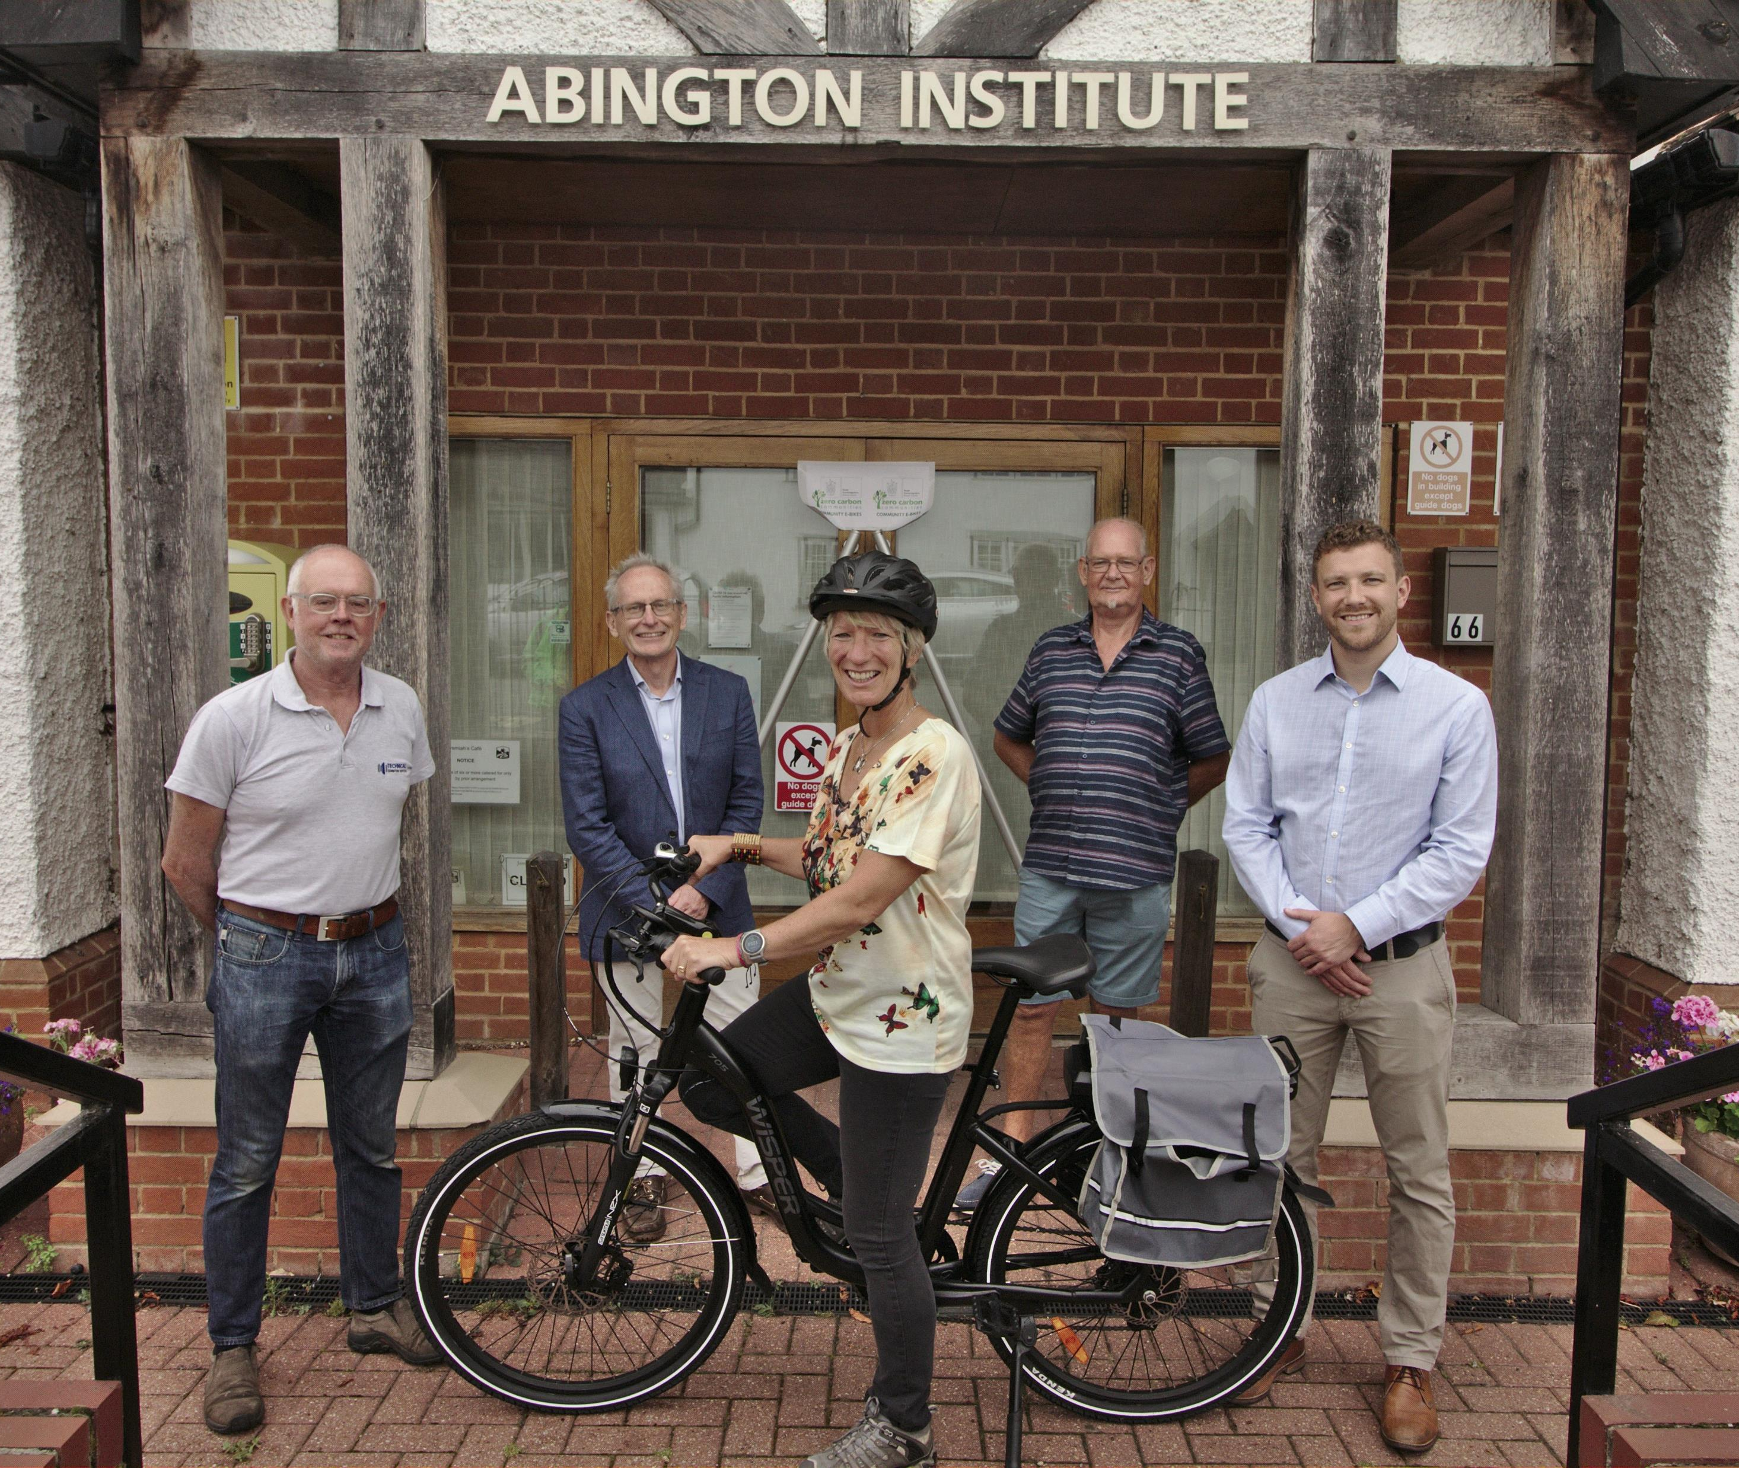
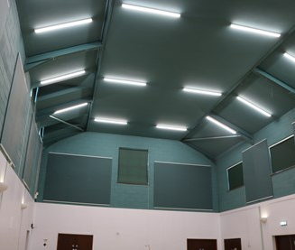
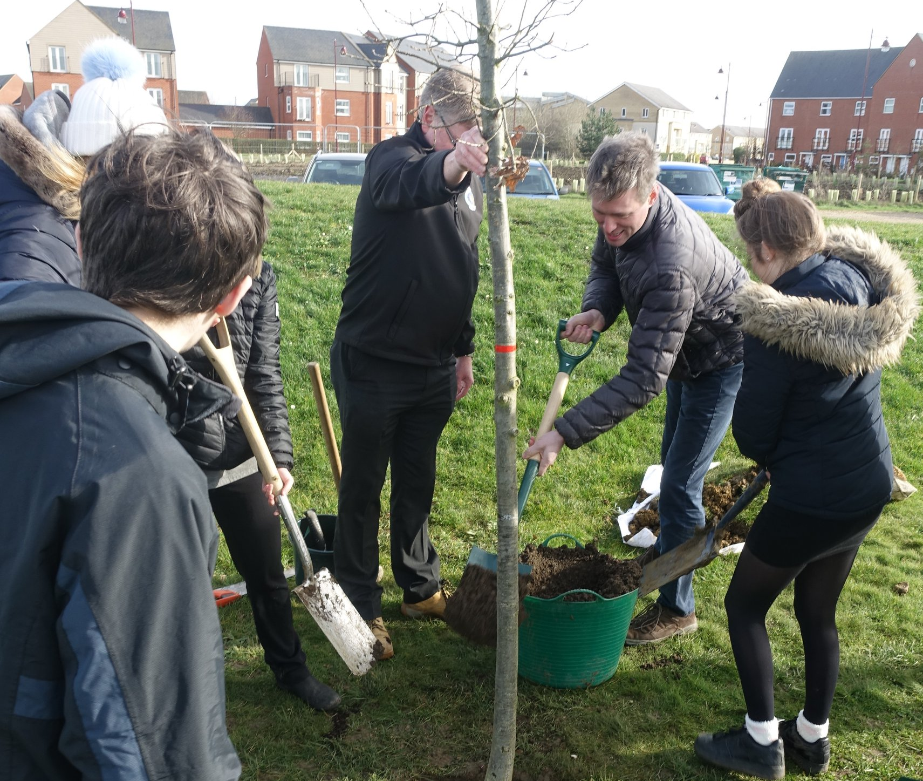
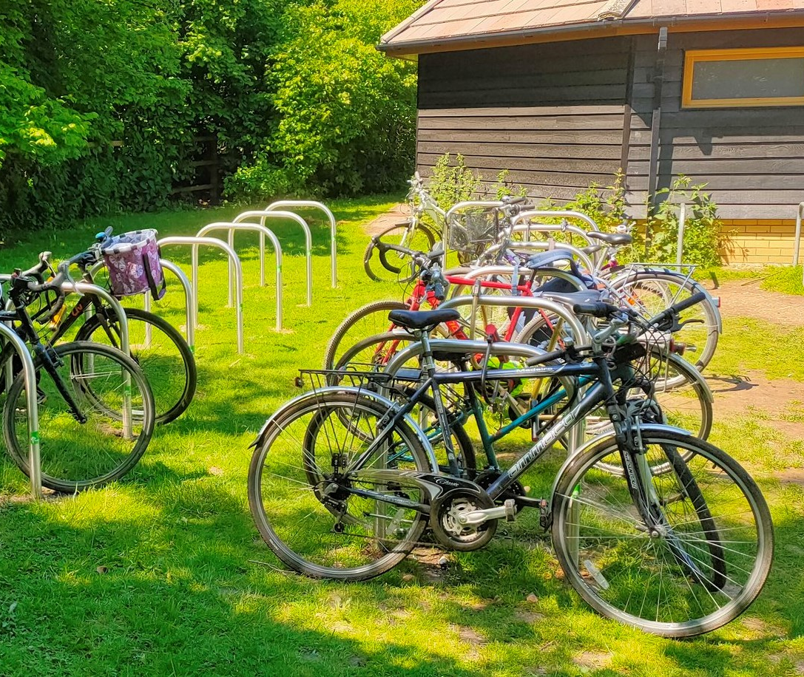
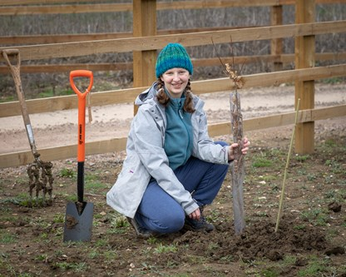
Pictures of funded projects

Slide 8
Applications invited
Applications invited from | parish councils and community groups
Total available | £100,000
Min/max grant | £1,000 - £15,000
Grant scheme open | Monday 10 May 2021
Application deadline | 5pm Friday 30 July 2021

Slide 9
Who can apply?
Who can apply?
Any non-profit group or organisation based in South Cambridgeshire or benefiting South Cambridgeshire residents, OR a South Cambridgeshire parish council.

Slide 10


This year there will be three funding streams:
Community buildings (40%)
Nature (40%)
Other Projects (20%)

Slide 11
Objectives
Objectives:
Objectives:
Achieving wider community engagement and behaviour change around climate change (33%)
Reduced CO2 in the atmosphere (33%)
Additional value (33%)

Slide 12
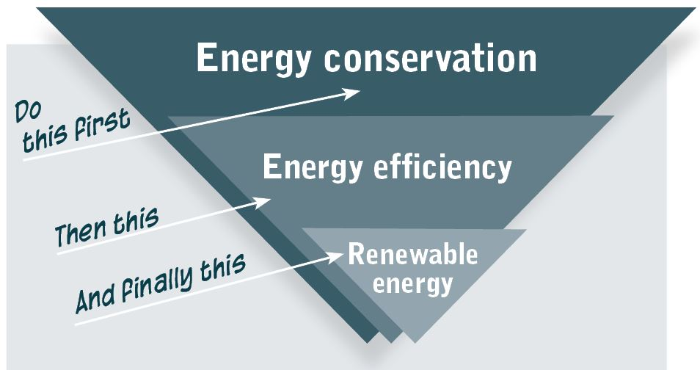
Community buildings
Community buildings
Energy conservation or efficiency measures
Solar PV and/or battery storage system for solar PV

Slide 13

Nature
Nature
Funding for a variety of tree-planting and other nature-based solutions to help combat climate change and increase biodiversity including project management and consultancy

Slide 14
Examples
Some examples to consider….
Planting of a landmark tree in a small open space
Planting of a small tree population
Community orchard project
Community tree nursery project
Community allotment project
Creation or enhancement of a community nature area
Small-scale restoration of peatland.
Hedge or larger village-wide tree canopy project.

Slide 15
Other projects
Other projects
Of interest are bold, ambitious and imaginative projects that are able to fulfil the given objectives to a high standard.

Slide 16
Other examples
Examples:
Community initiatives and events that promote sustainable lifestyle choices
Improvement to cycling infrastructure
A project to promote cycling
Waste reduction projects

Slide 17
Application process
Application process
We have made the application process easier
You can choose one of our options or devise your own project
You can apply for more than one project or apply to us again if you were successful in the past.
All projects need to meet the objectives

Slide 18
Before you apply
Before you apply…
Take time to read the guidance notes
Remember that part-funding is looked upon favourably
For funding less than £1,000, you can apply to the Community Chest
Discuss your project with us (optional). Email zcc@scambs.gov.uk

Slide 19
How to apply
How to apply:
via our online webpage:
www.scambs.gov.uk/zerocarbongrant

Slide 20
Further information
Further information:
Emma Dyer
Project Officer, Climate and Environment
Emma.dyer@scambs.gov.uk
01954 713344
Siobhan Mellon
Development Officer, Climate and Environment
Siobhan.mellon@scambs.gov.uk
01954 3195

Slide 21


Tips for successful grant applications
Tips for making successful grant applications.
Sally Page, Development Worker
Cambridge Council for Voluntary Service
Cambridge Council for Voluntary Service
Company Limited by Guarantee Number 3731848
Registered Charity No 1074947

Slide 22
What is your project
What is your project?
  What is the problem?
  Who will be involved in the project?
  What will the project do?
  What will you achieve?
  How will you measure what you do?
  What resources will you need?
  What will happen once you’ve spent the grant?

Slide 23
Getting ready to apply
Getting ready to apply
  Who could fund your project?
  Support Cambridgeshire
  What does the funder need from you?
  Be constituted
  Have a bank account in the name of the group
  Accounts to show income & expenditure
  Have all the appropriate permissions
  Built relevant partnerships
  Key policies in place

Slide 24
Writing the application
Writing the application
  Read the guidance and talk to the funder
  Use a clear writing style and be concise
  Answer the questions
  Find a critical friend
  Make sure the budget adds up
  Check and check again

Slide 25
Enquiries
"Alone we can do so little; together we can do so much"
Helen Keller
enquiries@cambridgecvs.org.uk
sally@cambridgecvs.org.uk
Tel: 07935 649805
www.cambridgecvs.org.uk
Cambridge Council for Voluntary Service
Company Limited by Guarantee Number 3731848
Registered Charity No 1074947

Slide 26
Gamlingay eco group
Sherryl Cousins Gamlingay ECO Community Group

Slide 27

Why was it set up?
The community group was set up to raise awareness of environmental impact and to encourage the community to make better informed decisions to reduce their carbon footprint.
To help the community of Gamlingay to use less single use plastic
To help the community learn more about what they can and cannot recycle in their area

Slide 28
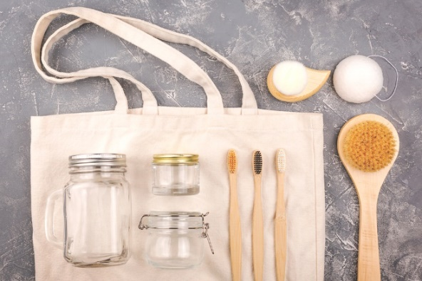
Engaging with public
Monthly “pop up Eco shop” at the ECO hub Gamlingay where the public can come along to find out about plastic free products and pick up free samples to try.
Using social media (Facebook page) and engage the community by highlighting alternatives to the use of single use plastic and ways to reduce waste.
Writing articles in the Gamlingay Gazette about the group and pop up Ecoshop and encourage the community to drop in and meet us.
Hold sessions with the local Rainbows, Brownies and Guides in the village to work with them to reduce single use plastic products.

Slide 29
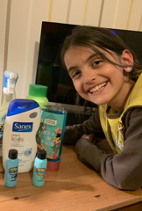
Brownies and Guides (attended virtual sessions)
Brownies and Guides were asked to collect all their single use plastic items from their bathrooms, and we discussed the products and explored suitable non plastic swaps.
After the sessions we provided every Brownie and Guide with a FREE shampoo bar or soap bar to replace plastic bottles products and asked them to give them a try!
We have had follow up sessions to see how they got on with the products and plan to repeat a year later to see if they have reduced single use plastic waste from their home.

Slide 30
Questions
Questions

